Slide 1
Data Bricks – H.o.L.
David Crook |
[TEAM MEMBERS]
Commercial Software Engineering | Discrete Manufacturing

Slide 2
Sci-Ops First Approach
Combination of Dev Ops, Software Engineering, Data Science and Machine Learning.
Provide Flexibility to Scientists & Software Engineers
Add Rigor and Control of Dev Ops
Source Control, Version Control, Release Control, Quality Control
Higher Quality, Tested, Containerized Assets
Include Complexities of mathematically generated assets

Slide 3
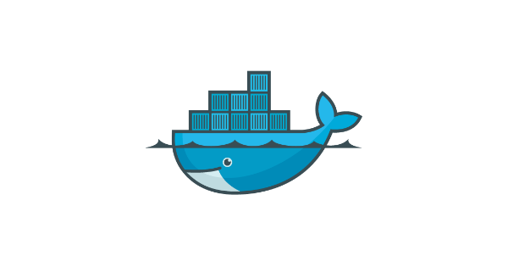






Scenario to Support
Azure
Consume Scientific
Assets
Containerized Models
(& Restful Endpoints)
Scientific Assets
Science Team
Product Dev Team
Data Lake
Create &
Maintain Product
Model Updates
& Ops Logs
Model Updates,
Ops Logs
& Scientific Assets
New Scientific Data
& Operational Logs
Product
Consume
Product
Consume
Product
Delivery &
Maintenance Team
Deliver & Maintain
Solution
Customer
Notes:
Science team may or may not produce restful endpoints; that very well may fall onto the shoulders of a product dev team.

Slide 4
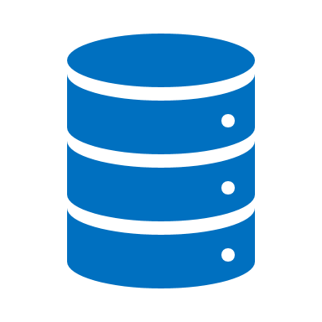

Basic Sci-Ops Structure
2 Stage Release Pipeline
Passes Local
Quality Checks
Gated
Promotion
Dev DL
Pipeline DL
Code Check In
Autonomous
Quality Checks
Test DL
Prod DL
Dev Environment
Dev Ops Build
Science Team
Consumers of Scientific Assets

Slide 5
Multi-Tenant
2 Stage Release Pipeline
Customer A
Test
Gated Promotion
Prod
Passes Local
Quality Checks
Dev DL
Pipeline DL
Code Check In
Autonomous
Quality Checks
2 Stage Release Pipeline
Dev Environment
Dev Ops Build
Customer B
Test
Gated Promotion
Prod
Science Team

Slide 6
Multi-Tenant & Team
Dev DL
2 Stage Release Pipeline
Dev Environment
Customer A
Passes Local
Quality Checks
Test
Gated Promotion
Prod
Code Check In
Pipeline DL
Science Team B
Autonomous
Quality Checks
2 Stage Release Pipeline
Passes Local
Quality Checks
Dev DL
Dev Ops Build
Code Check In
Customer B
Test
Gated Promotion
Prod
Dev Environment
Science Team A

Slide 7


Experimentation Loop
Dev Model Registry
Inference Code
Test Code
Dev DL
Code Check In,
Dev Branch
Check In Dev – Branch &
Pull Request - Master
Local_Build_And_Test.cmd Script
Dev Environment
Science Team

Slide 8
Autonomous CI/CD
Dev Ops Build
2 Stage Release Pipeline
Pipeline DL
Check In Dev – Branch &
Pull Request - Master
Train on Pipeline Cluster
Register Model in Pipeline Registry
Build & Test Container
Prod
ACR
Passes
Quality Checks -
Publish Build Artifacts
Test
ACR
Gated
Promotion
Consumers of Scientific Assets
Notes:
For more control over multi-tenant or where geo-political constraints are in place; you may repeat training in a release pipeline specific for the region or tenant of concern.

